Slide 2



Hardening – Basics
Credentials
Change defaults
Account Management
Administrative Accounts
Default Configurations
OS
Applications
Patch Management

Slide 3




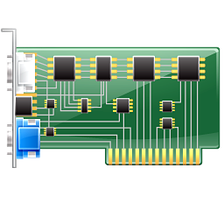
Hardening – Firmware Protection
UEFI vs. MBR
Updates (patch management)
Trusted Platform Modules
Secure Boot
Protection out-of-band management

Slide 4






Hardening – Ports and Services
Ports
Logical end-point connection
Identifies a service
Can be used by attackers
Services
Provides networking resources
Increased attack surface
Can be exploited by attackers
Notes:
Client presents the list of supported cipher suite

Slide 5
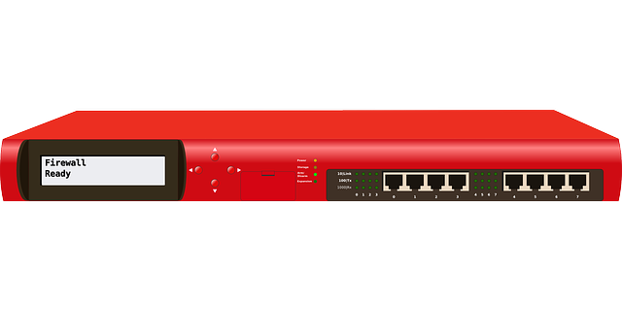






Hardening - Firewalls
Implicit deny
Services
HIDS/HIPS
Stateful monitoring
Notes:
Client presents the list of supported cipher suite

Slide 6







Hardening – Anti-virus
Real time protection
Automated scanning
Platform and signature updates
Logging
Configure default actions
Notes:
Client presents the list of supported cipher suite

Slide 7




Hardening – File and Disk Encryption
File encryption
EFS
APFS
GPG
Disk encryption
BitLocker
File Vault
LUKS
Notes:
GNU Privacy Guard
Linux Unified Key Setup (disk encryption)

Slide 8


Hardening – Registry
Windows only
Hierarchical settings/configuration database
Lease privilege
Admins – modify
Standard users – read access
Notes:
GNU Privacy Guard

Slide 9
Hardening – Registry
Made up of hives
HKEY_CLASSES_ROOT
HKEY_CURRENT_USER
HKEY_LOCAL_MACHINE
HKEY_USERS
HKEY_CURRENT_CONFIG
Stored in six or more files
SAM, DEFAULT, SOFTWARE, SECURITY, SYSTEM, DRIVERS
C:\Windows\System32\Config\
Notes:
HKCR – File extension to application mapping
HKCU – Configuration information for user currently logged in
HKLM – Configuration information for the computer
HKU – Contains all actively load profiles (HKCU is a subkey of HKU)
HKCC – Contains information about the hardware profile used a startup
Show the registry

Slide 10
Hardening – Vendor Hardening Guides
Microsoft Security Compliance Toolkit
RHEL Guide
VMWare hardening guide
Notes:
Microsoft Security Compliance Toolkit
https://docs.microsoft.com/en-us/windows/security/threat-protection/security-compliance-toolkit-10
RHEL
https://access.redhat.com/documentation/en-us/red_hat_enterprise_linux/8/pdf/security_hardening/Red_Hat_Enterprise_Linux-8-Security_hardening-en-US.pdf
VMWare Hardening Guides
https://www.vmware.com/security/hardening-guides.html

